Slide 1
Generating Variations of Fugues using Chaotic Mapping onto Coupled Lorenz Attractors
Gowri Shankar Raju Kurapati (gowri.kurapati@colorado.edu)
CSCI 5446 - Chaotic Dynamics
Project Presentation
Notes:
Good Morning Everyone!
My name is Gowri Shankar and today, we will look at my project
“Generating Variations of Fugues using Chaotic Mapping onto coupled Lorenz Attractors”.

Slide 2
Contents
Introduction
Research Question
Background
Methodology
Demo
Survey
Questions?
Notes:
But before that ,
I will give you a little introduction about the project
And then my research question.
I will also give you a background on the concepts that I have used and talk about the method that I have used to generate variations of music.
Since I am constrained on time, I will try to play the music variations at the end.
Most of you should have already listened to them, to answer the survey that was shared by Liz on Friday.
If you haven’t filled out the survey, please take the time to fill it. I will be compiling the results again in the morning, tomorrow.

Slide 3
Introduction
Chaotic Mapping
Synchronization of Lorenz Attractors
Novel Approach to generating music
Notes:
In the course, we have touched briefly upon Diana Dabby’s work to create variations of music using sensitive dependence on initial conditions of chaotic systems.
To recall, we have seen how when two chaotic systems can be synchronized using coupling.
To the best of my knowledge, this is the very first time we are leveraging two well-studied concepts to generate music variations.

Slide 4
Research Question
By leveraging the concepts of synchronizing attractors and chaotic mapping, how coherent can the musical variations of a two-voice fugue generated be?
Notes:
With all this said, the research question that I am trying to answer is,
“By leveraging the concepts of synchronizing attractors and chaotic mapping, how coherent can the musical variations of a two-voice fugue generated be? “
To answer this question, I first generated the music variations and evaluated those variations using a survey-based study.

Slide 5
Background
Chaotic Mapping
Synchronization of Chaotic Attractors
Fugue in Music Theory
Notes:
Coming to the little bit of background,
Zach has already covered Diana Dabby’s work.
So, I will skip that part and we will look at different types of synchronization and
what fugues are?

Slide 6
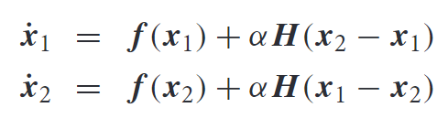

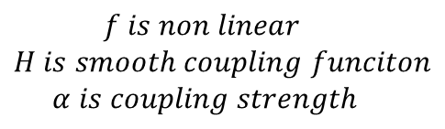
Synchronization
Different Types of Synchronization
Complete/ Identical Synchronization
Master/Slave Coupled Systems
General Synchronization
State of one system completely determined by other
Y = F(X)
Phase Synchronization
$$f is non linear$$
$$H is smooth coupling funciton$$
$$α is coupling strength$$
Notes:
Synchronization of chaos is a phenomenon that may occur when two or more dissipative chaotic systems are coupled.
There are different types of synchronization.
One of them is,
Complete/ Identical Synchronization which is observed for identical chaotic systems. We say that chaotic systems are completely synchronized when there is a set of initial conditions so that the systems eventually evolve identically in time.
There is also a sub-class system called Master-Slave systems, unlike two systems being interdependent on each other, only one system called the master drives the other system.
Generalized Synchronization - This is observed for coupled chaotic oscillators which are different or sometimes when they are the same too. Generalized synchronization occurs when the transitory evolution from appropriate initial conditions is passed , the dynamical state of one of the oscillators is completely determined by the state of the other, that x is the state of one system, phi(X) would be the state of second system.
Phase synchronization occurs when the coupled chaotic oscillators keep their phase difference bounded while their amplitudes remain uncorrelated. This phenomenon occurs even if the oscillators are not identical.

Slide 7
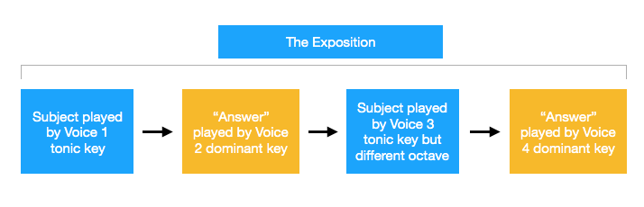


Fugue
Derived from the French word fugue or the Italian fuga (meaning: “to chase”)
Basic Structure
Exposition
Subject
Answer
Episode
Coda
Notes:
So coming to Fugues,
I will only cover the basic structure of fugue and in general, it is a little complex.
A simple note before we proceed, I have no idea about music theory and sorry, if there is any abuse of terminology.
So, In music theory, fugue is a compositional technique that is built on two or more voices. A voice is nothing but the instrument you play it on. Sometimes, different melodies are played on different instruments or the same instrument at the same time. Then we say that music is on multiple voices.
The opening of a fugue is known as its exposition.
A fugue exposition begins with the introduction of its central melody, the subject.
The subject is the primary motif of the entire fugue and will be the template for other melodies.
The subject can be played on any voice.
The subject is then followed by an answer, which is a near-exact copy of the subject that is played by a different voice in either the dominant or subdominant key.
For instance, if the first voice plays the fugue's subject in C major, the second voice would play the answer in the key of either F major or G major.
An episode is a connecting passage of music in a fugue and is usually made up of the development of the music that has already been heard in the Exposition.
The Coda is he final section of music whose primary aim is to move the piece to an appropriate conclusion
If an answer contains the exact same melody as the subject (just played in a different key), it is known as a "real answer." If the answer is slightly altered to account for the new key, it is called a "tonal answer." The answer can be contrapuntally accompanied by a new melody called the countersubject.

Slide 8
Methodology
Couple two identical Lorenz Attractors and let them synchronize
Chaotic Mapping of two voices of ‘two voice Fugue’ separately onto two Lorenz Attractors
Create perturbation in any of the systems. Capture the variant during this asynchronous phase as they reach synchronization.
Notes:
Now that we have covered the topics required,
Let us look at the method to generate variations,
The first step is to couple two Lorenz attractors and let them synchronize.
Now, we do the chaotic mapping of two voices of fugue separately onto the attractors, the same as Diana Dabby’s work.
Now we introduce a perturbation, i.e. changing the state, in any of the systems, either randomly or nearest neighbor technique.
The coupling guarantees that the systems evolve to synchronization again over some time.
So, during this phase of asynchronization, we capture the variants from the two attractors and the combined music is the variant.
The synchronization safeguards the originality of the structure of the fugue to some extent and this is the purpose of coupling.
Ideally, I would like the evaluation done using fugue theory but have resorted to a survey-based study due to time constraints.

Slide 9
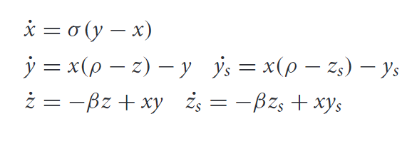
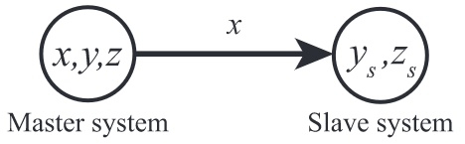
Synchronization Used
Coupled Lorenz Systems
Master - Slave Configuration
Notes:
I have used two Lorenz systems which are coupled using master-slave configuration to generate music variations for this project. Here the x-coordinate of the first system is tied to the other system.

Slide 10

Demo (Two Voice Fugue)
Invention-12 from 15 Inventions, BWV 772-786 (Bach, Johann Sebastian)
Original Piece : Variant :
Invention-15 from 15 Inventions, BWV 772-786 (Bach, Johann Sebastian)
Original Piece : Variant :
Notes:
I will skip the demo and get back if time permits.

Slide 11
Survey
Design
Results
Notes:
We will first look at the survey design and see the results from the responses that I have gathered till yesterday.

Slide 12

Design
Likert Type Survey
Response Format: Strongly Agree, Agree, Neutral, Disagree, Strongly Disagree
Likert Scales in the Survey
How coherent the music variations are?
The song maintained a sense of coherence and harmony.
The song sounded random
How similar is the variant to the original?
The song sounded like the original (by comparing it to the original)
Are music variants enjoyable?
I enjoyed listening to the song
I want to listen to variations of this type again (by comparing them to the original)
Notes:
We are using the Likert Scale survey as it is a profound method to measure people’s attitudes or opinions towards narratives.
To capture that attitude, the respondents are presented with a series of statements and asked to mark their agreement on a five-point scale response format.
We assign value for each point, .i.e 5 for SA and 4 for A, and so on 1 for SD.
The narratives that we are trying to capture are,
The coherence of variations, the similarity of variants to the original, and if variants are enjoyable.
Together these three sub-scales would answer my research question.

Slide 13
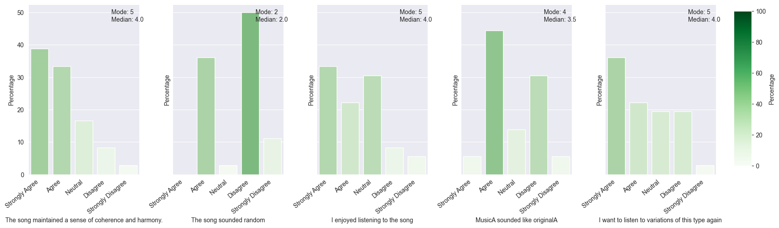
Results
Music A

Slide 14
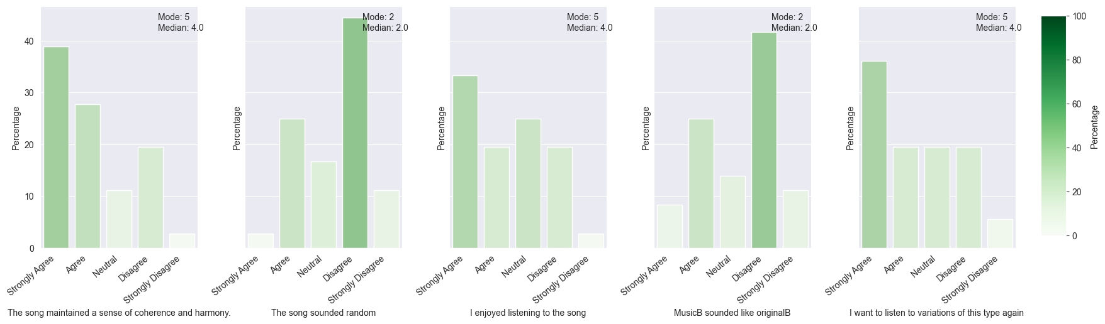
Results
Music B

Slide 15
Results
 | Mean | Std | Median | Mode | Min | Max | Cronbach's alpha | No of Likert items
Coherence | 16.5 | 3.55 | 16.5 | 18 | 8 | 20 | 0.80 | 4
Different from Original | 5.92 | 2.03 | 6.0 | 4 | 2 | 10 | 0.72 | 2
Enjoyable | 14.61 | 4.58 | 14.0 | 20 | 4 | 20 | 0.94 | 4
Overall | 35.02 | 7.79 | 35.0 | 42 | 18 | 49 | 0.857 | 10
Notes:
Cronbach’s alpha is a measure used to assess the reliability, or internal consistency, of a set of scale or items.
The value of Cronbach’s Alpha is usually expressed as a number between .00 and 1.0. A value of .00 means no consistency in measurement while a value of 1.0 indicates perfect consistency in measurement. The acceptable range is between 0.70 and 0.90

Slide 16

Future Work
Using different types of synchronizing techniques
Multiple Voice Fugues
Different Perturbation Techniques
Analyzing variants using Fugue Theory
Questions?

